Slide 1


ONLINE ADMISSION TEST AND PROCTORING (2022-2023)
Advisor : Sir Ali Shaukat

Slide 2
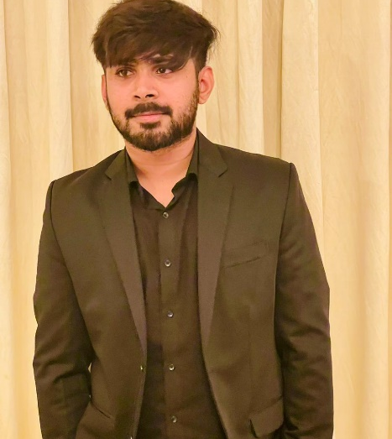


Infographic Style
Team Members
Hamid Ali 2019144
Mian Ali Shah
2019235
Ameer Hamza
2019293

Slide 3

Problem Statement
proctor remote online examinations is an important limiting factor to the scalability of this next stage in education.
Limitations in Existing system
Simultaneously Proctoring is not possible.
If a student misses an exam rescheduling exam is not possible.
Difficult to interface for students and it is not user friendlyfor students.
Balanced and random categorization of questions in exam is not available
Proposed system
We have proposed a web based system to identify and analyze the mal practices carried out by tgw students during online exam using Artificial intelligence.

Slide 4
Type of Project?
This is a software based Project

Slide 5
Proposed Features
1
Screenshots of webcam and screen at random interval
AI Proctoring (Irrelevant application detection, Double face detection , Face spoofing, Eye Tracking, Mouth Opening detection, Mobile Phone detection, etc)
2
3
Bluetooth devices detection(Projector, etc)
Audio detector
4
4
IP and Mac Address Validation
5

Slide 6
Proposed Features
6
Keyboard Typing detection
7
Large Question Bank
8
Ability to import / export question
4
9
10

Slide 7
Motivation for the Project
Candidates do not have to waste time walking from one location to another to complete their examination.
The Key advantages of the distant online entrance exam is the convenience of administration.
The results are much quicker, as the software can mark and present the results for the candidates
It saves the administrator a lot of time.

Slide 8
Justification of Scope
In Pakistan, the number of internet users has nearly quadruple in the past 3 years.
According to researchers, 37 % of students preferred remotely instruction, compared to 9% who prefer a hybrid model and 54 % who reported they'd rather learn in person.
This proved to be a windfall for academics as many students could continue their education remote via internet
This also facilitated examinations to go online which brought the concept of online proctoring at the academic level.
A proctored exam allows the invigilators to invigilate remotely.
.

Slide 9

Ethical Impact
The ability to efficiently proctor remote online examinations is an important limiting factor to the scalability of this next stage in education.
10%
40%
20%
30%

Slide 10

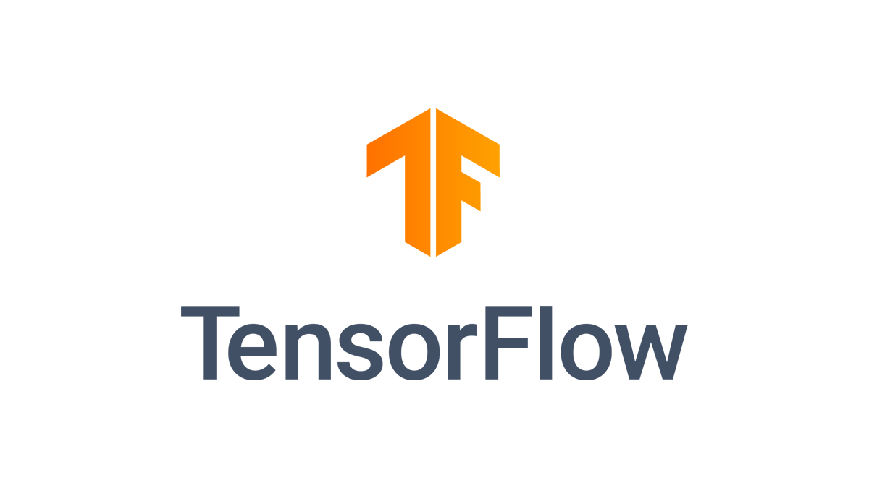
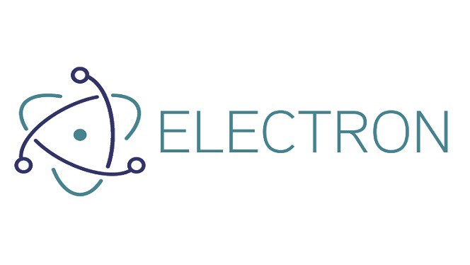



Tools & Technology

Slide 11
Wide Ranging Technical Issue
02
Developing a robust backend
Building an intuitive UI/UX
01
Machine learning of automated proctoring for detection of unfair means usage
03

Slide 12
Components Parts
Two individual components integrated to realize the application
Examination dashboard where questions & answers can be created in an exam. Results can be published and viewed
01
Automated Proctoring module where instructors can view live monitoring of exam and view proctoring logs of the students
02

Slide 13



Diverse Group of Stakeholders

Slide 14
References
1
E-cheating Prevention Measures: Detection of Cheating at Online Examinations Using Deep Learning Approach - A Case Study Leslie ChingOw Tiong and HeeJeong Jasmine Lee
2
Research on Abnormal Behavior Detection of Online Examination Based on Image Information Senbo Hu1 , Xiao Jia2 , Yingliang Fu3 Dalian Maritime University College of Information Science and TechnologyDalian, Liaoning Email:senbo@dlmu.edu.cn, jiaxiao222@126.com,fuyl8125@dlmu.edu.cn
.
3
Prince, D.J., Fulton, R.A. and Garsombke, T.W. 2009. Comparisons Of Proctored Versus Non-Proctored Testing Strategies In Graduate Distance Education Curriculum. Journal of College Teaching & Learning (TLC). 6, 7 (Nov. 2009). DOI:https://doi.org/10.19030/tlc.v6i7.1125.

Slide 15
Thank You
Any Questions?

